Slide 1

IoT Based Doctor Eye
Post Graduate Diploma in Internet of Things
Presented by:
Ms. Nancy Rastogi( 220340126017)
Ms. Pragati Gaikwad(220340126009)
Ms. Sakshi Janghel (220340126023) Ms. Pratiksha Panchal (220340126019)

Slide 2
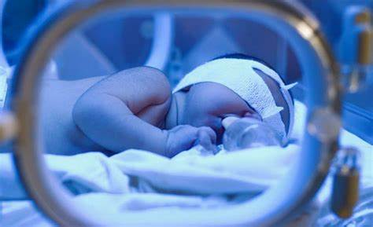
Introduction
The care of new born babies are the most important and sensitive part of bio-medical domain. Some new born babies have a higher risk of mortality due to their gestational age or their birth weight. Most of the premature babies born on 32-37 weeks of gestation and are deceased due to their unmet need for warmth.
This project is to overcome the drawbacks of an unmonitored incubator and develops an affordable and safe device for real-time monitoring of the neonatal incubator. a low cost yet effective apparatus for monitoring the important parameters like pulse rate, temperature, humidity, Oxygen of the premature baby inside an incubator.

Slide 3
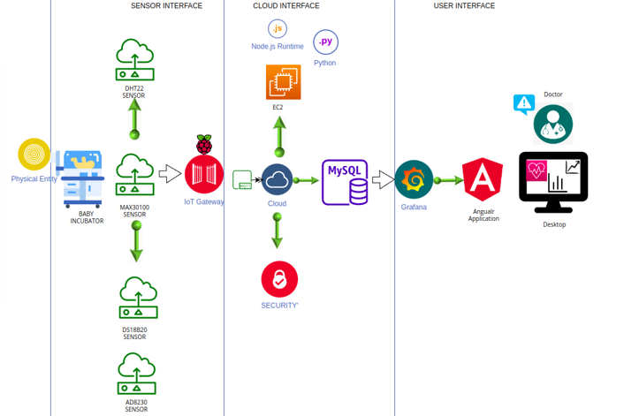
Architecture

Slide 4
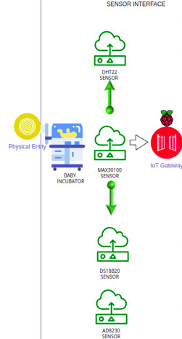
Sensor Interface
-DHT22:Room Temperature
-Max3010: Pulse rate
-DS18B20: Oxygen and Humidity
-AD8232: Body Temperature

Slide 5
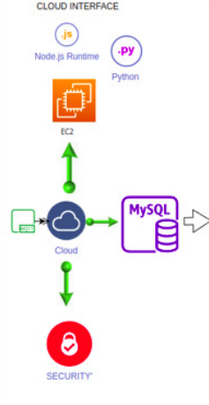
Cloud Interface
-EC2 Instance: cloud storage
-MySQL: Data Storage
-Security: MQTT over TLS

Slide 6
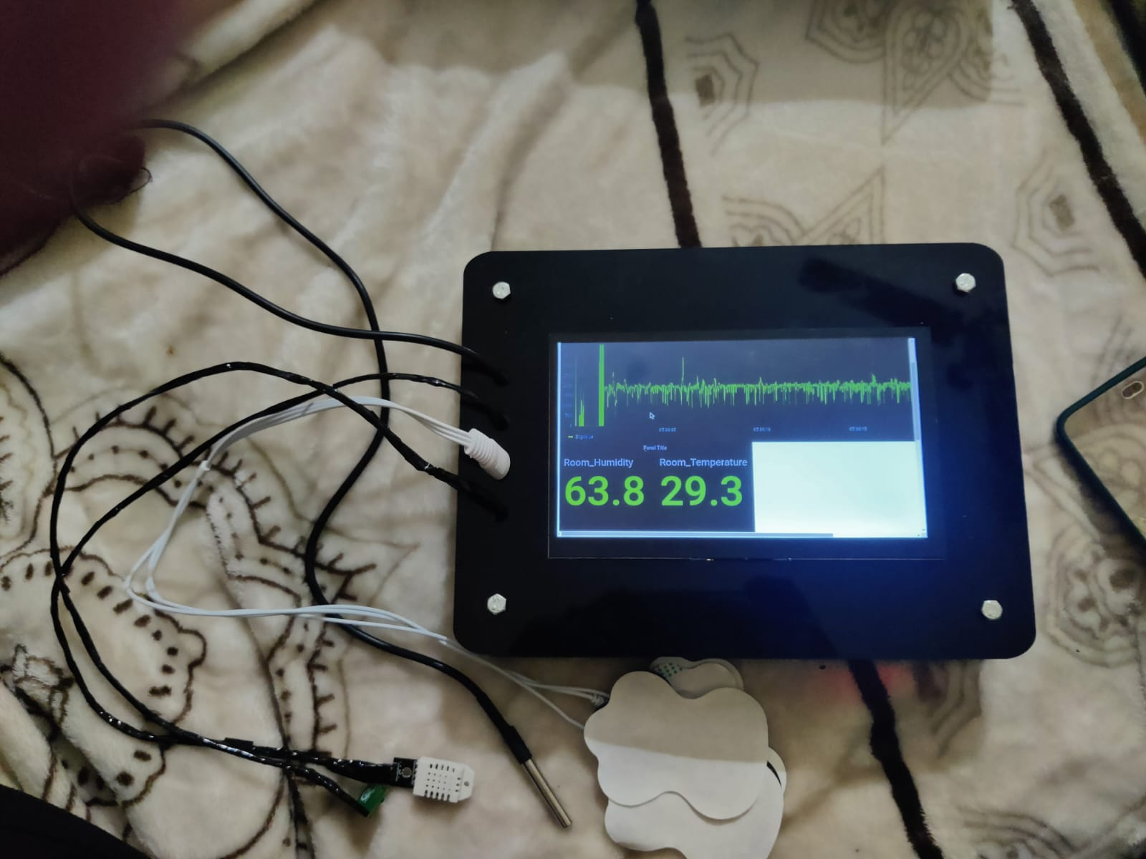
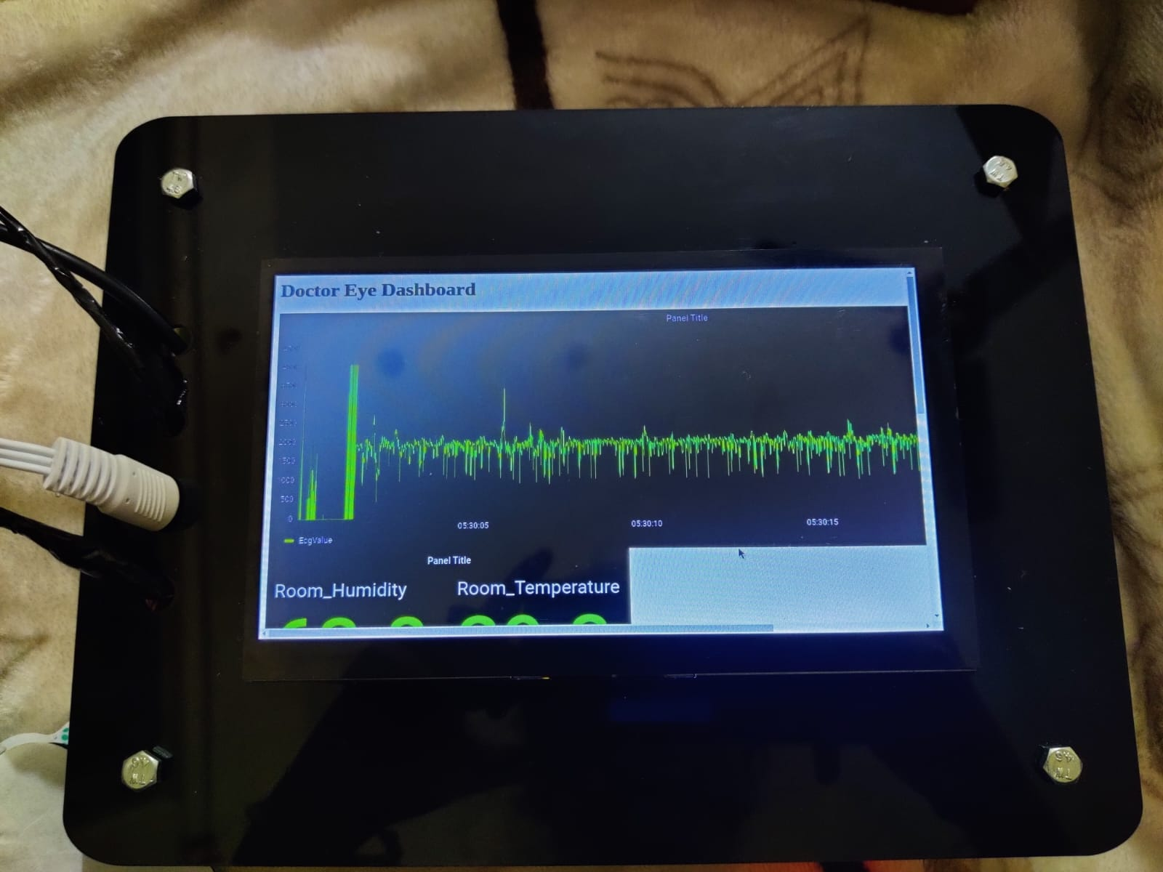
Project Prototype

Slide 7
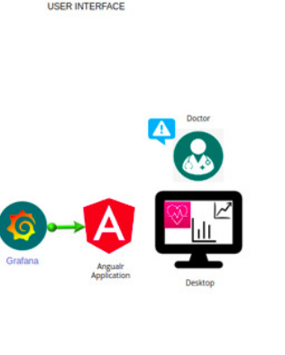
User Interface
- Angular front end

Slide 8
THANK YOU

